Slide 1
Understanding Recommendation Systems
Zhoufa Chen
Yousif Khaireddin
Krishna Palle
ENG EC503
Learning From Data
Fall ‘19

Slide 2
Introduction

Slide 3
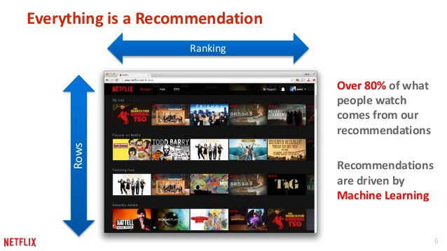
What is recommendation system? Netflix is a good example
Kevin Liao,2018. https://towardsdatascience.com/

Slide 4

Motivation
Why we need recommendation systems?
Better understand what the user needs.
Sell more products and services.
Increase the user satisfaction.
Increase user fidelity.

Slide 5
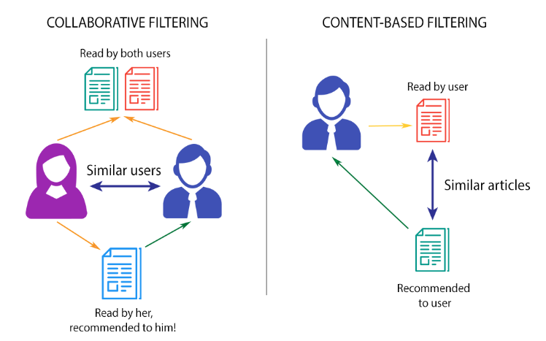
Techniques for recommendation system
1
2
3
HYBRID: a mixture of the above two methods
Kevin Liao,2018. https://towardsdatascience.com/

Slide 6
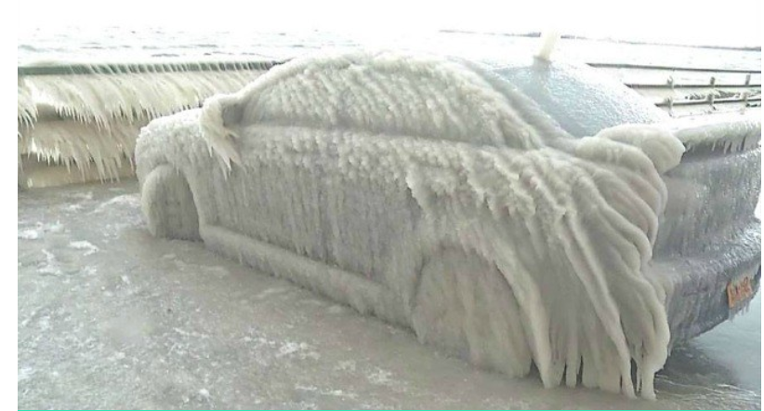
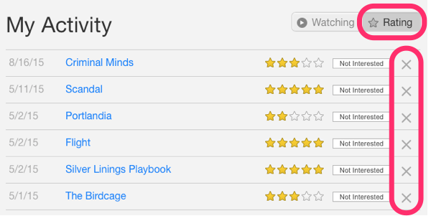
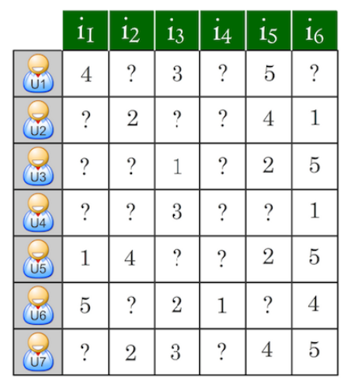
Challenges in recommendation system
Cold start
3. User privacy
Not optimal at the beginning
Huba Gaspar,2015.yuspify.com/blog/
2. Data sparsity
PULKIT SHARMA, JUNE 21, 2018,https://www.analyticsvidhya.com/blog/
https://web.csulb.edu/~rforsati/research.html

Slide 7
Datasets

Slide 8
Datasets
Synthetic Data
MovieLens 1M
Generation
Looped addition of d dimensional outer-product of a vector to a rank controlled identity matrix dxd
Control Parameters
Rank
Dimension
Density
Attributes
6040 users
3883 movies
Density: 4.26%
A
Metadata
Age
Occupation
Gender
Genre

Slide 9
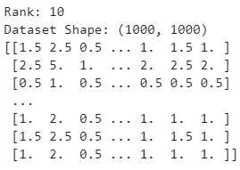
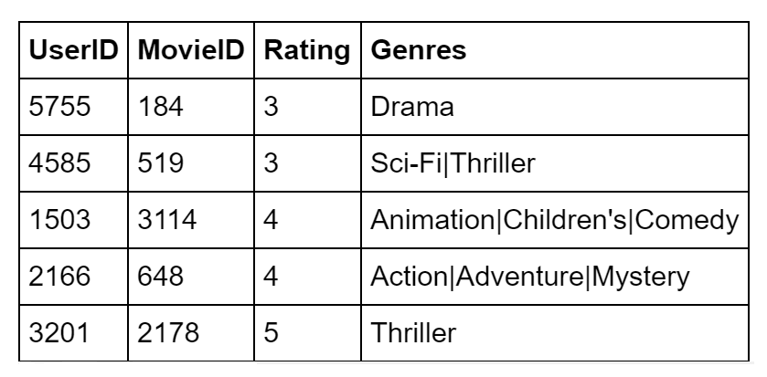
Datasets
Synthetic Data
MovieLens 1M

Slide 10
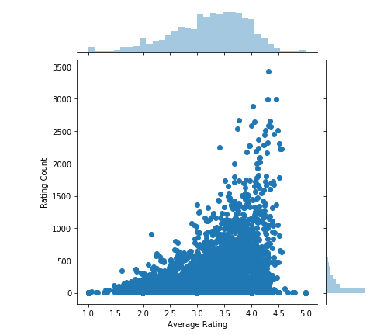
Visualizing MovieLens 1M
Observations
Most movies have a rating count below 500
The average rating of all entries is roughly 3.7
There seems to be a positive correlation between rating count and average rating

Slide 11
Approach

Slide 12
Approach
Algorithm | Data
Correlation | Ratings
Singular value decomposition (SVD) | Ratings
Linear regression: OLS, Ridge | User & Movie info (Metadata)
SVD & Linear regression | Rating data + Meta data

Slide 13
Correlation

Slide 14
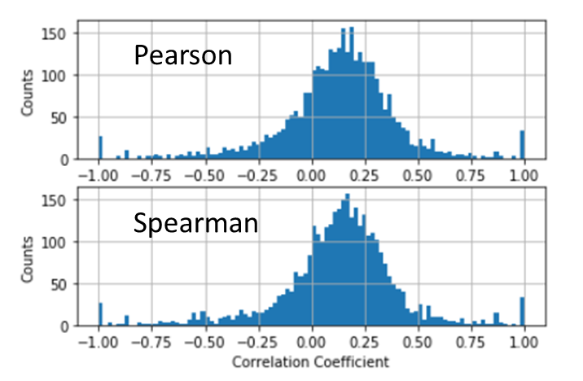
Correlation – MovieLens 1M
Observations
Most coefficients are roughly zero
Changing the function from Person to Spearman yielded little to no difference
The notion of correlation is slightly ambiguous with extremely sparse vectors
Main Issue
Recommendations are given based on aggregate user behavior, ignoring variations in user to user preferences

Slide 15
SVD

Slide 16
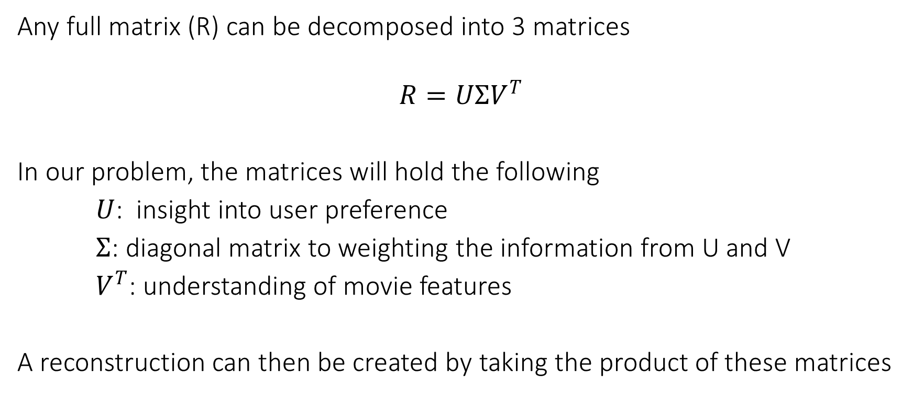
SVD – Overview
Any full matrix (R) can be decomposed into 3 matrices
$$R=UΣV^{T}$$
In our problem, the matrices will hold the following
$U$: insight into user preference
$Σ$: diagonal matrix to weighting the information from U and V
$V^{T}$: understanding of movie features
A reconstruction can then be created by taking the product of these matrices
Koren, Y., Bell, R. and Volinsky, C., 2009. Computer, (8), pp.30-37

Slide 17
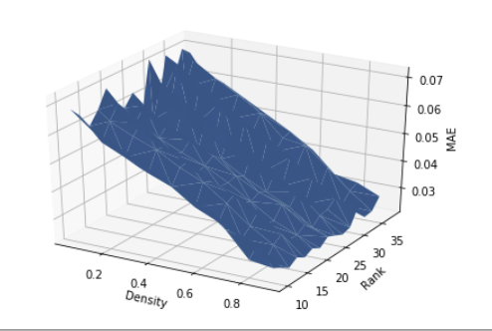
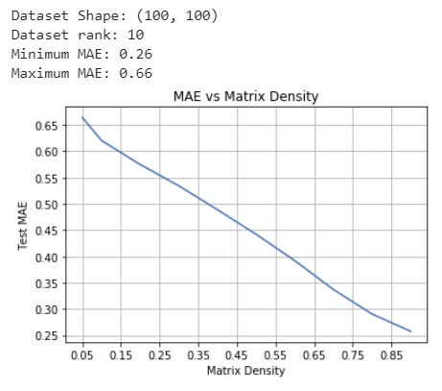
SVD – Synthetic Data Understanding Parameters
MAE vs. Matrix Density and Rank
MAE vs. Density (rank = 10)

Slide 18
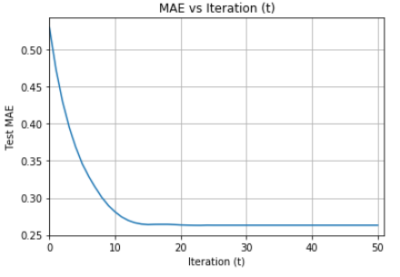
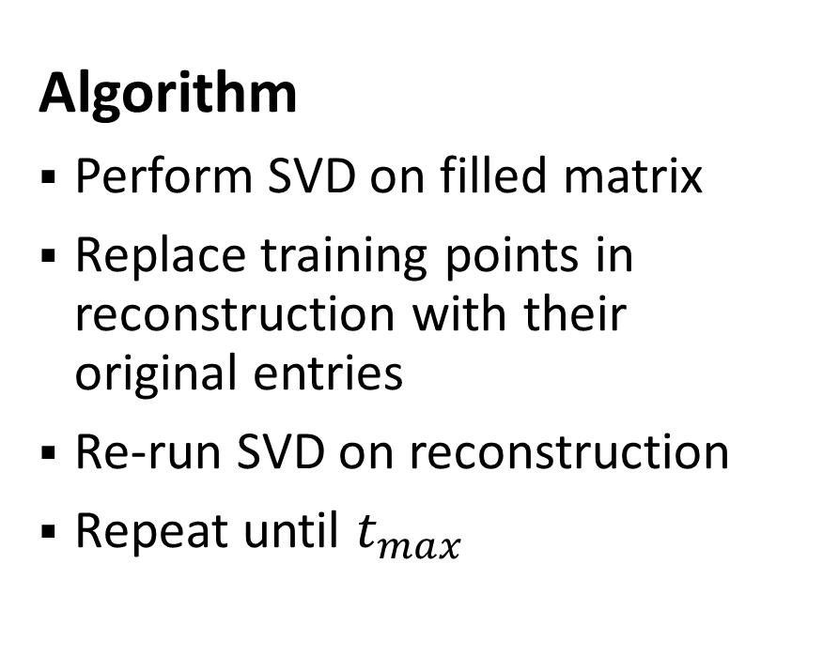
Iterative SVD – Synthetic Data
Algorithm
Perform SVD on filled matrix
Replace training points in reconstruction with their original entries
Re-run SVD on reconstruction
Repeat until $t_{max}$

Slide 19
Iterative SVD – MovieLens 1M Matrix Completion Approaches
Method | Initial MAE | Final MAE
Zeros | 3.581 | 1.083
Average User Rating (AUR) | 0.829 | 0.714
Average Movie Rating (AMR) | 0.782 | 0.701
Average of AUR and AMR | 0.771 | 0.699

Slide 20
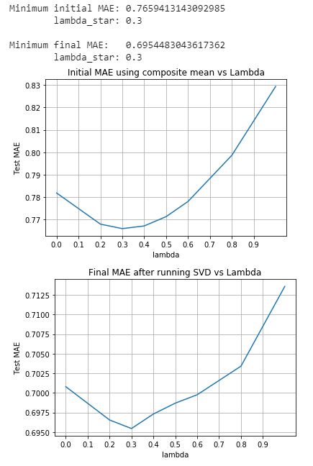

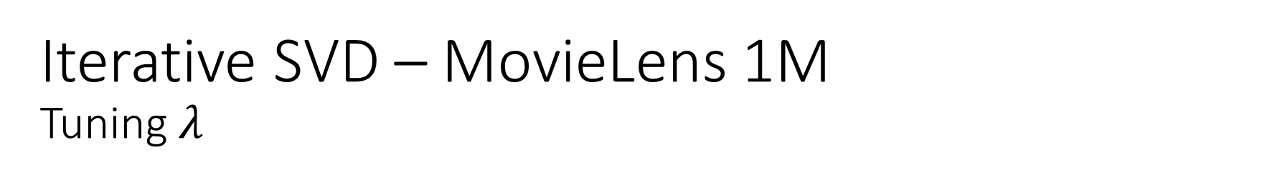

Iterative SVD – MovieLens 1M Tuning $λ$
$${Matrix Entry}_{um}= λ{(AUR)}_{u}+\left(1−λ\right){AMR}_{m}$$
${\text{λ}}^{∗}$ = 0.3
minimum initial MAE = 0.766
minimum final MAE of 0.695

Slide 21
Regression

Slide 22
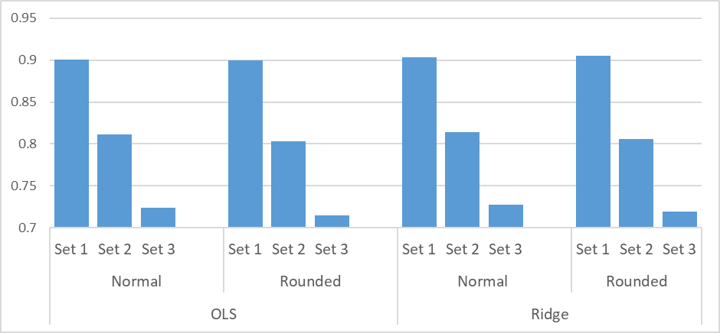
Linear Regression Incorporating metadata
Feature Set 1
MovieID
UserID
Age
Occupation
Gender
Genre
Feature Set 2
Feature Set 1
Average User Rating
Feature Set 3
Feature Set 2
Average Movie Rating

Slide 23
Linear Regression Incorporating metadata
Feature Set 1
MovieID
UserID
Age
Occupation
Gender
Genre
MAE | Normal | Rounded
OLS | 0.901 | 0.900
Ridge | 0.903 | 0.905
Feature Set 2
Feature Set 1
Average User Rating
Feature Set 3
Feature Set 2
Average Movie Rating
MAE | Normal | Rounded
OLS | 0.811 | 0.803
Ridge | 0.814 | 0.806
MAE | Normal | Rounded
OLS | 0.724 | 0.715
Ridge | 0.728 | 0.719

Slide 25
Take home message

